Slide 1
From M. Clore review:
 | Exchange rate | R₂ | R₁
CEST | 10-1,000 Hz (depending on the chemical shift difference) K_{f}, K_{b} < R_{1(free)} , Δω | R_{2 (free)} << R_{2 (bound)} | R_{1 (free)} < R_{1 (bound)}
DEST | 10-2,000 Hz K_{f}, K_{b} < R_{1(free)} , | >500 Hz R_{2 (free)} << R_{2 (bound)} | R_{1 (free)} < R_{1 (bound)}
Our systems:
System | Dendrites (free) |  |  | SEI/bound state |  |  | Electrolyte (free)
 | Shift | T₁ | T₂ | Shift | T₁ | T₂ | Shift | T₁ | T₂
Li dendrites | +260ppm/40kHz (width 2.5kHz) | 150ms | 0.5ms | -2 to +2 ppm (width 30-40kHz) | 10-100s | 0.1ms | 0 | 2.2s | 0.4s
Na dendrites | 1100ppm/120kHz | 10ms | 4ms | -50 to +50 ppm | 10-100s | 0.1ms | 0 | 3.8ms | 3.7ms
TiO₂ |  |  |  |  |  |  |  | 2.2s | 0.3s
This approach is valid under the assumption of a small SEI pool (fraction f SEI≪1) with negligible longitudinal relaxation compared to its transverse relaxation and exchange rates, R1,SEI ≪ R2,SEI, kSEI−metal.

Slide 2
CEST:
1st case: What are the limits of the exchanges rates that can be measured Li dendrites/SEI (fraction of 1: 0.02)
K=0.01Hz-1000Hz, RF: 250Hz-2000Hz; time up to 1s.
2nd case: What are the limits of the exchanges rates that can be measured Na dendrites/SEI (fraction of 1: 0.02)
K=0.01Hz-1000Hz, RF: 250Hz-2000Hz; time up to 1s.
DEST:
1st case: What are the limits of the exchanges rates that can be measured Na/Li electrolyte/SEI (fraction of 1:0.01-0.1)
K=0.01Hz-1000Hz, RF: 250, 500, 2000Hz; time up to 2s.
2nd case: What are the limits of the exchanges rates that can be measured Li electrolyte/TiO2 (fraction of 1:0.05-0.25)
K=0.01Hz-1000Hz, RF: 250Hz-2000Hz; time up to 2s.
For bound state: (a)T₁=0.1ms; T2=0.05ms
(b) T₁= 0.1s; T₂=0.05s
(c) T₁=0.5s; T₂=0.2s

Slide 3
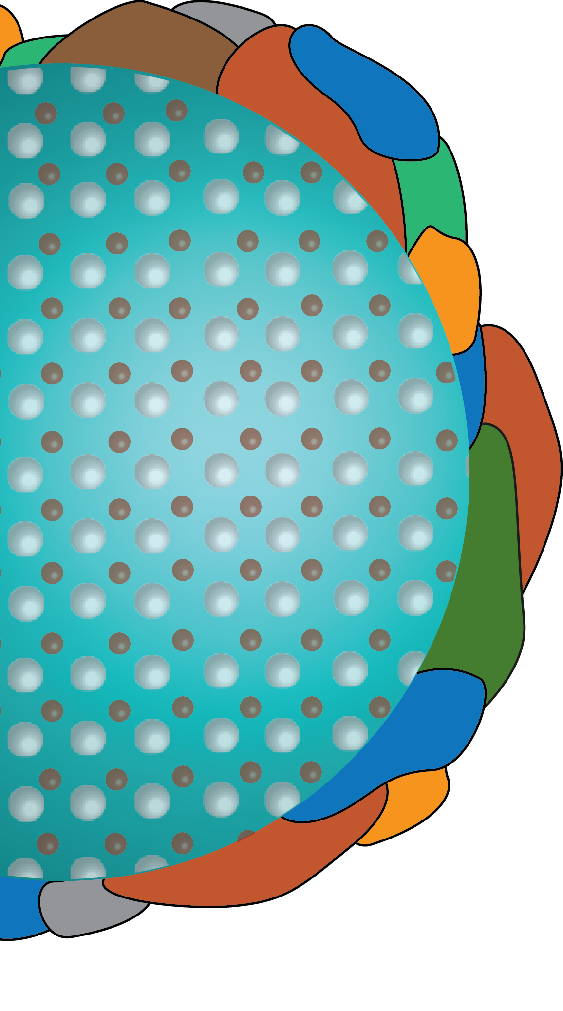
How do ions cross the electrode-electrolyte interface?
(i) desolvation &
surface binding
O
O
(ii) migration
across SEI
+
O
O
(iii) electrode-SEI
interface
What surface chemistry leads to efficient binding?
O
What phases or structures are permeable to ions?
+
+
+
O
What controls transport at the SEI-electrode interface?
What makes a good interface and
how can we design one?
electrode
electrolyte

